Slide 1

Course-End Project [Capstone Project 2]
Project Domain: E-commerce Sentiment Analysis
By Raushan kumar
Aspiring Data Analytics
Notes:
Anuj Kumar Raushan

Slide 2
Project Summary
The course-end project analyses sentiments expressed in over 34,000 reviews for Amazon brand products within the e-commerce domain. The dataset contains attributes such as brand, categories, review titles, review text, and sentiment levels categorized into "Positive," "Negative," and "Neutral." The project aims to predict sentiment or satisfaction levels based on various features and review text
** Objectives of the Project: ● Understand the sentiment expressed in consumer reviews. ● Address class imbalance in sentiment categories. ● Implement classifiers and advanced techniques for sentiment analysis. ● Evaluate model performance using appropriate metrics. ● Compare traditional machine learning algorithms with neural network approaches. ● Explore topic modelling techniques for clustering similar reviews

Slide 3
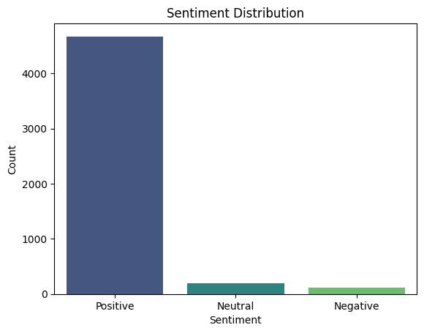
Exploratory Data Analysis : Plot the Sentiment Distribution
The graph represents the Sentiment Distribution of a dataset. It categorizes sentiments into three groups:
Positive Sentiment: Significantly higher count, indicating the majority of responses or data points are positive.
Neutral Sentiment: A much smaller count compared to positive.
Negative Sentiment: Slightly less than neutral, but still minimal compared to positive.

Slide 4
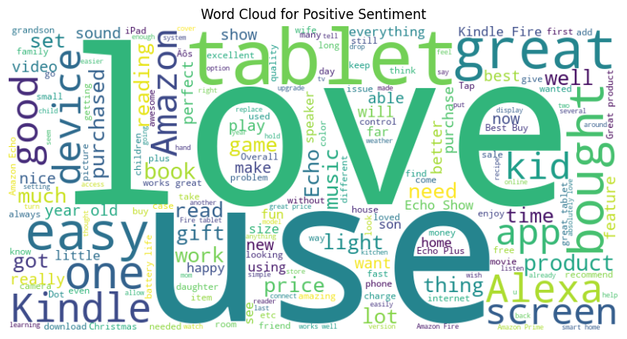
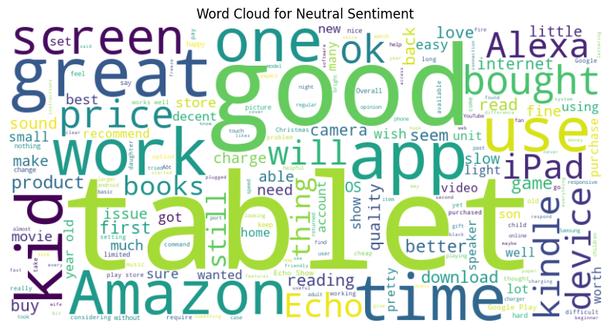
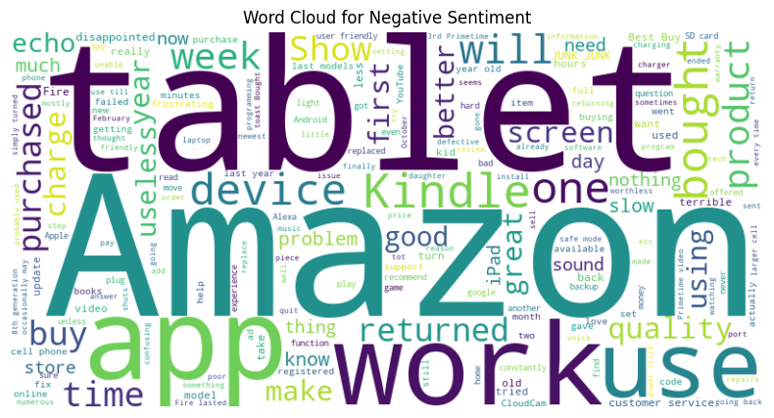
Analyses Most Frequent Words (Word Cloud)
This word cloud represents negative sentiments related to Amazon products and services. Here’s an analysis based on the prominent words in the graph: Key Insights:
General Issues with Products: The most frequent words, such as tablet, Kindle, and app, suggest users face problems with these devices and associated applications. Words like screen, device, and work highlight frequent issues related to functionality and quality.
2. Customer Frustrations: Terms like returned, useless, frustrating, and problem reflect dissatisfaction, leading to product returns or expressing disappointment in reviews.
3. Purchase and Use Problems: Words such as purchased, bought, and use point to problems encountered after buying or while using the product.
4. Amazon Branding: "Amazon" being a large focus indicates a strong association between dissatisfaction and the company's name.5. Performance Issues:
Positive Sentiment Insights:
Dominant Words:
Love, Tablet, Great, and Easy are highly prominent, suggesting customers appreciate the usability and quality of tablets.
Kid, Kindle, and Alexa are frequently mentioned, implying these products are popular with families and in relation to smart assistants.
Neutral Sentiment Insights:
Dominant Words:
Tablet, Good, Great, One, and Work are common, indicating general satisfaction with room for improvement.
Mentions of Screen, Price, and Device suggest customers focus on the product's specifications and affordability.

Slide 5
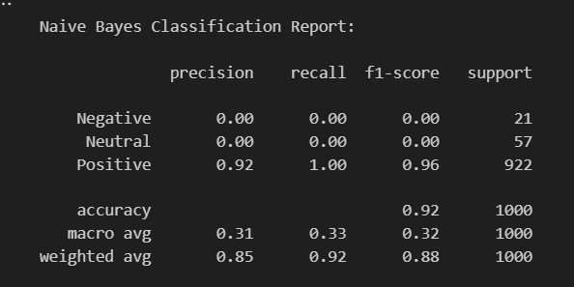
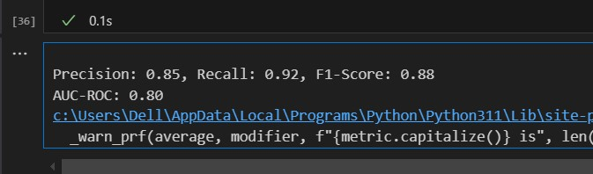
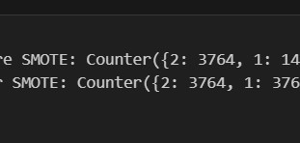
Tackling Class Imbalance
Classifier Selection
Classifier Selection
Evaluation Metrics
Calculate Precision, Recall, F1-score, and AUC-ROC
Tackling Class Imbalance
The table you've uploaded appears to show a classification report for a machine learning model. Here's a clean textual representation of the content:
if you'd like help analysing this, it seems that the model performs very well for the "Positive" class but completely fails to identify the "Negative" and "Neutral" classes. This suggests a strong class imbalance or an issue with the model's ability to generalize to minority classes. Let me know if you'd like to troubleshoot this further.
Precision (0.85):
Definition: Precision is the ratio of true positive predictions to the total number of positive predictions (true positives + false positives). It measures the accuracy of the positive predictions.
Interpretation: A precision of 0.85 means that 85% of the reviews predicted as a particular sentiment (Positive, Neutral, or Negative) were actually correct.
Explanation of Class Distribution Before and After SMOTE:
Class Distribution Before SMOTE:
Counter({2: 3764, 1: 140, 0: 96})
The dataset is heavily imbalanced:
Class 2 (likely Positive) dominates with 3,764 samples.
Class 1 (likely Neutral) has only 140 samples.
Class 0 (likely Negative) has just 96 samples.

Slide 6
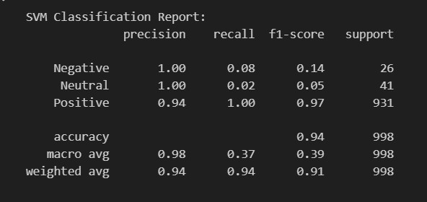
Model Selection and Advanced Techniques
Train multi-class SVM Model using sklearn:
Positive:
Precision: 0.94 – A slight drop compared to other classes, but still high.
* Recall: 1.00 – All actual "Positive" instances were correctly identified.
* F1-Score: 0.97 – Excellent performance due to high precision and recall.
Neutral:
* Precision: 1.00 – All predicted "Neutral" instances were correct.
* Recall: 0.02 – Only 2% of actual "Neutral" instances were identified, showing poor detection.
* F1-Score: 0.05 – The low recall severely impacted the F1-score.
Negative:
* Precision: 1.00 – All predicted "Negative" instances were correct.
* Recall: 0.08 – Only 8% of the actual "Negative" instances were identified, indicating significant misclassification.
* F1-Score: 0.14 – The low recall led to a poor F1-score.
Overall Accuracy
* Accuracy: 0.94 – The model correctly classified 94% of the total instances. However, the dominance of the "Positive" class (931 out of 998 instances) likely inflated this metric.

Slide 7
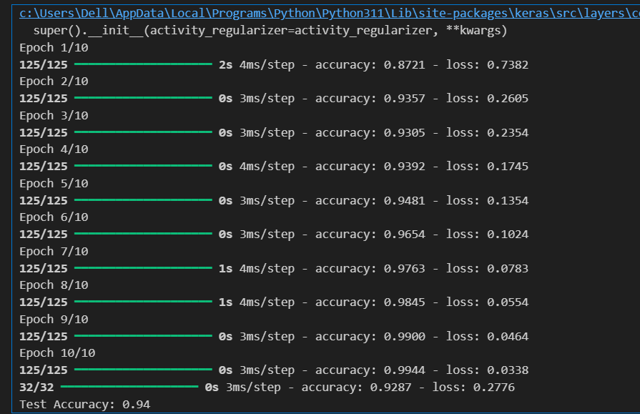
Neural Network Train a simple neural network using TensorFlow/Keras
Insights from the Training Logs
Key Metrics from the Logs:
Training Accuracy Progression:
The model's accuracy improves consistently from 87.21% (Epoch 1) to 99.44% (Epoch 10), indicating effective learning during training.
Loss Reduction:
The loss starts at 0.7382 (Epoch 1) and decreases steadily to 0.0338 (Epoch 10), suggesting the model is minimizing the error effectively.
Evaluation on Test Data:
The test accuracy is 92.87%, and the test loss is 0.2776, which indicates the model performs well on unseen data without significant overfitting.

Slide 8
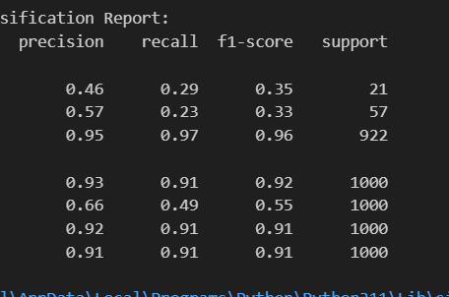
Ensemble Techniques Implement XGBoost or ensemble models combining différent classifier.
Negative Class:
Precision (0.46): The model correctly identifies 46% of instances classified as "Negative."
Recall (0.29): Only 29% of actual "Negative" instances are correctly classified.
F1-Score (0.35): Indicates weak performance due to imbalanced precision and recall.
Neutral Class:
Precision (0.57): The model correctly identifies 57% of instances classified as "Neutral."
Recall (0.23): Only 23% of actual "Neutral" instances are correctly classified.
F1-Score (0.33): Indicates subpar performance, likely due to a small number of samples.
Positive Class:
Precision (0.95): Excellent precision; 95% of instances classified as "Positive" are correct.
Recall (0.97): The model identifies 97% of actual "Positive" instances correctly.
F1-Score (0.96): Strong performance, as both precision and recall are high.

Slide 9



Complete this Project By Raushan kumar Aspiring Data Analytics

